Slide 1



DTU Compute Department of Applied Mathematics and Computer Science
Technical University of Denmark
The 38th Annual AAAI Conference on Artificial Intelligence
February 20-27, 2024 | Vancouver, Canada
Paper #7602
Continuous-time Graph Representation with Sequential Survival Process
Abdulkadir Çelikkanat, Nikolaos Nakis and Morten Mørup

Slide 2
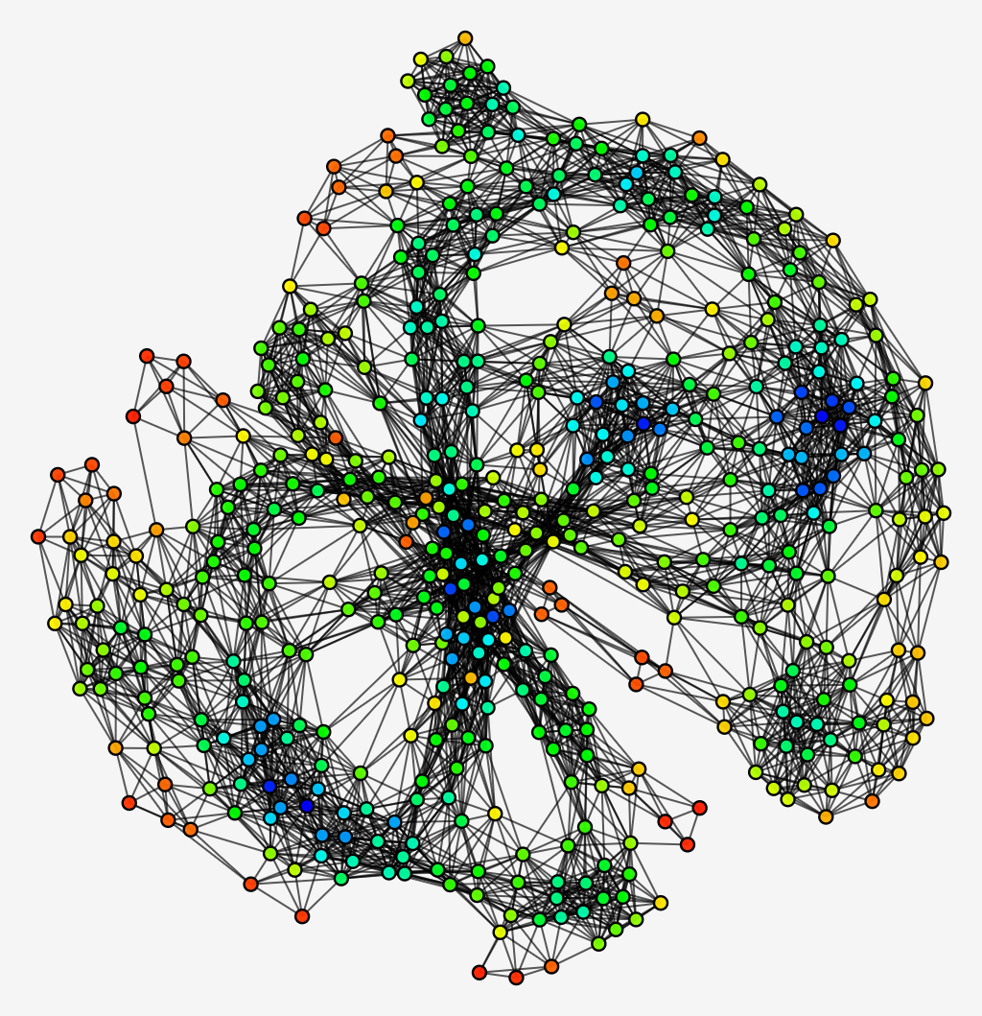
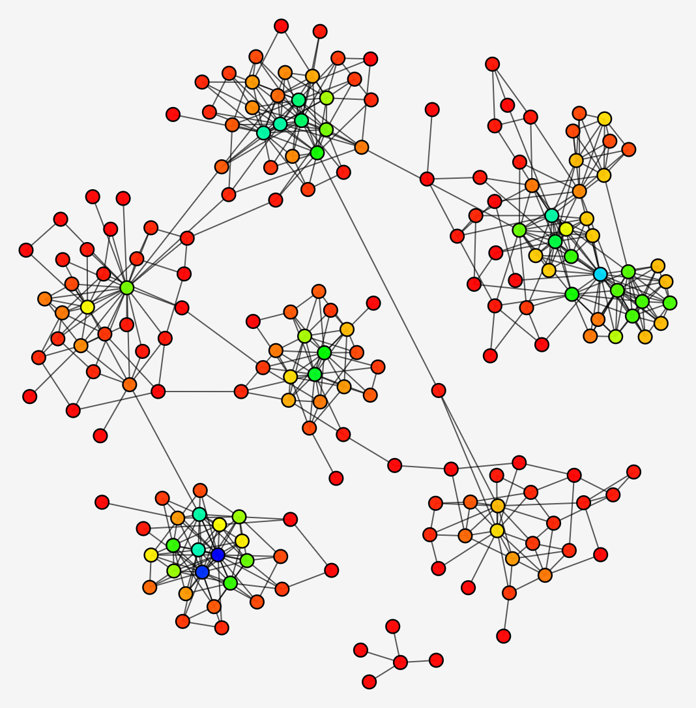
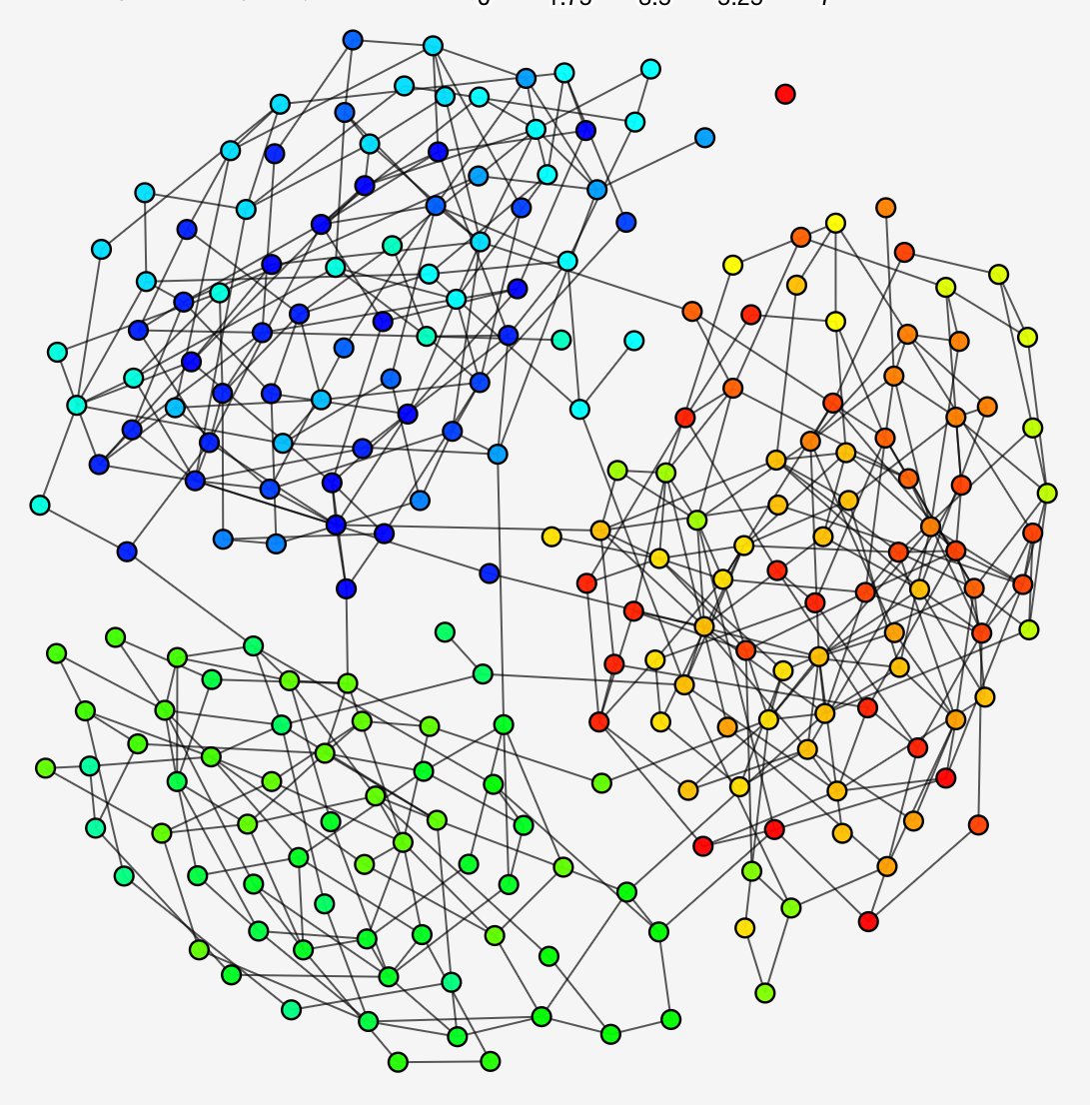
Graphs are everywhere
Graphs are everywhere
Protein-protein interaction networks
Friendship networks
Collaboration networks
Protein-protein interaction network
Friendship network
Collaboration network
Ref: Ryan A. Rossi and Nesreen K. Ahmed. The Network Data Repository with Interactive Graph Analytics and Visualization. In AAAI, 2015

Slide 3
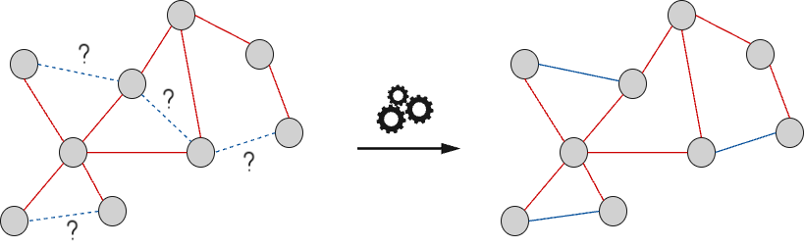
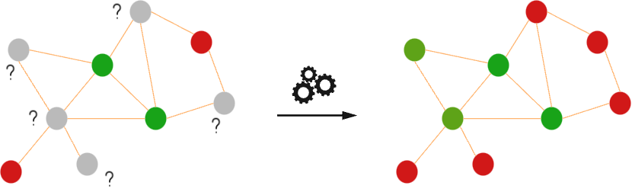
Motivation: Graph Representation Learning
Machine Learning Tasks
Node classification
Link prediction
Recommender systems (AirBnb, UberEats, Pinterest etc.)
Clustering
Other tasks:
Drug discovery, traffic prediction etc.

Slide 4
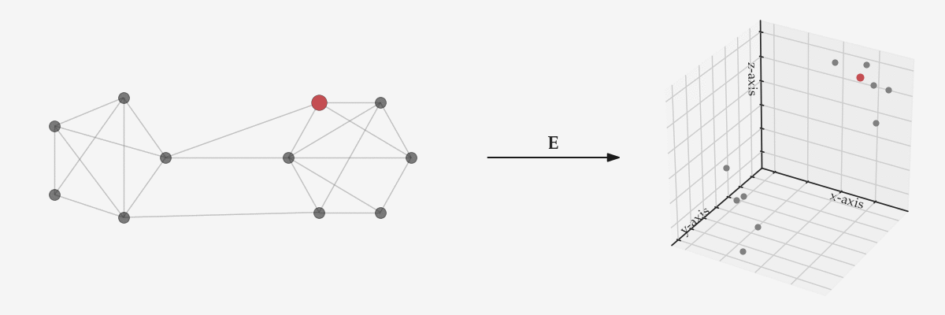
Graph Representation Learning
Illustration of Graph Representation Learning Models for Static Networks

Slide 5
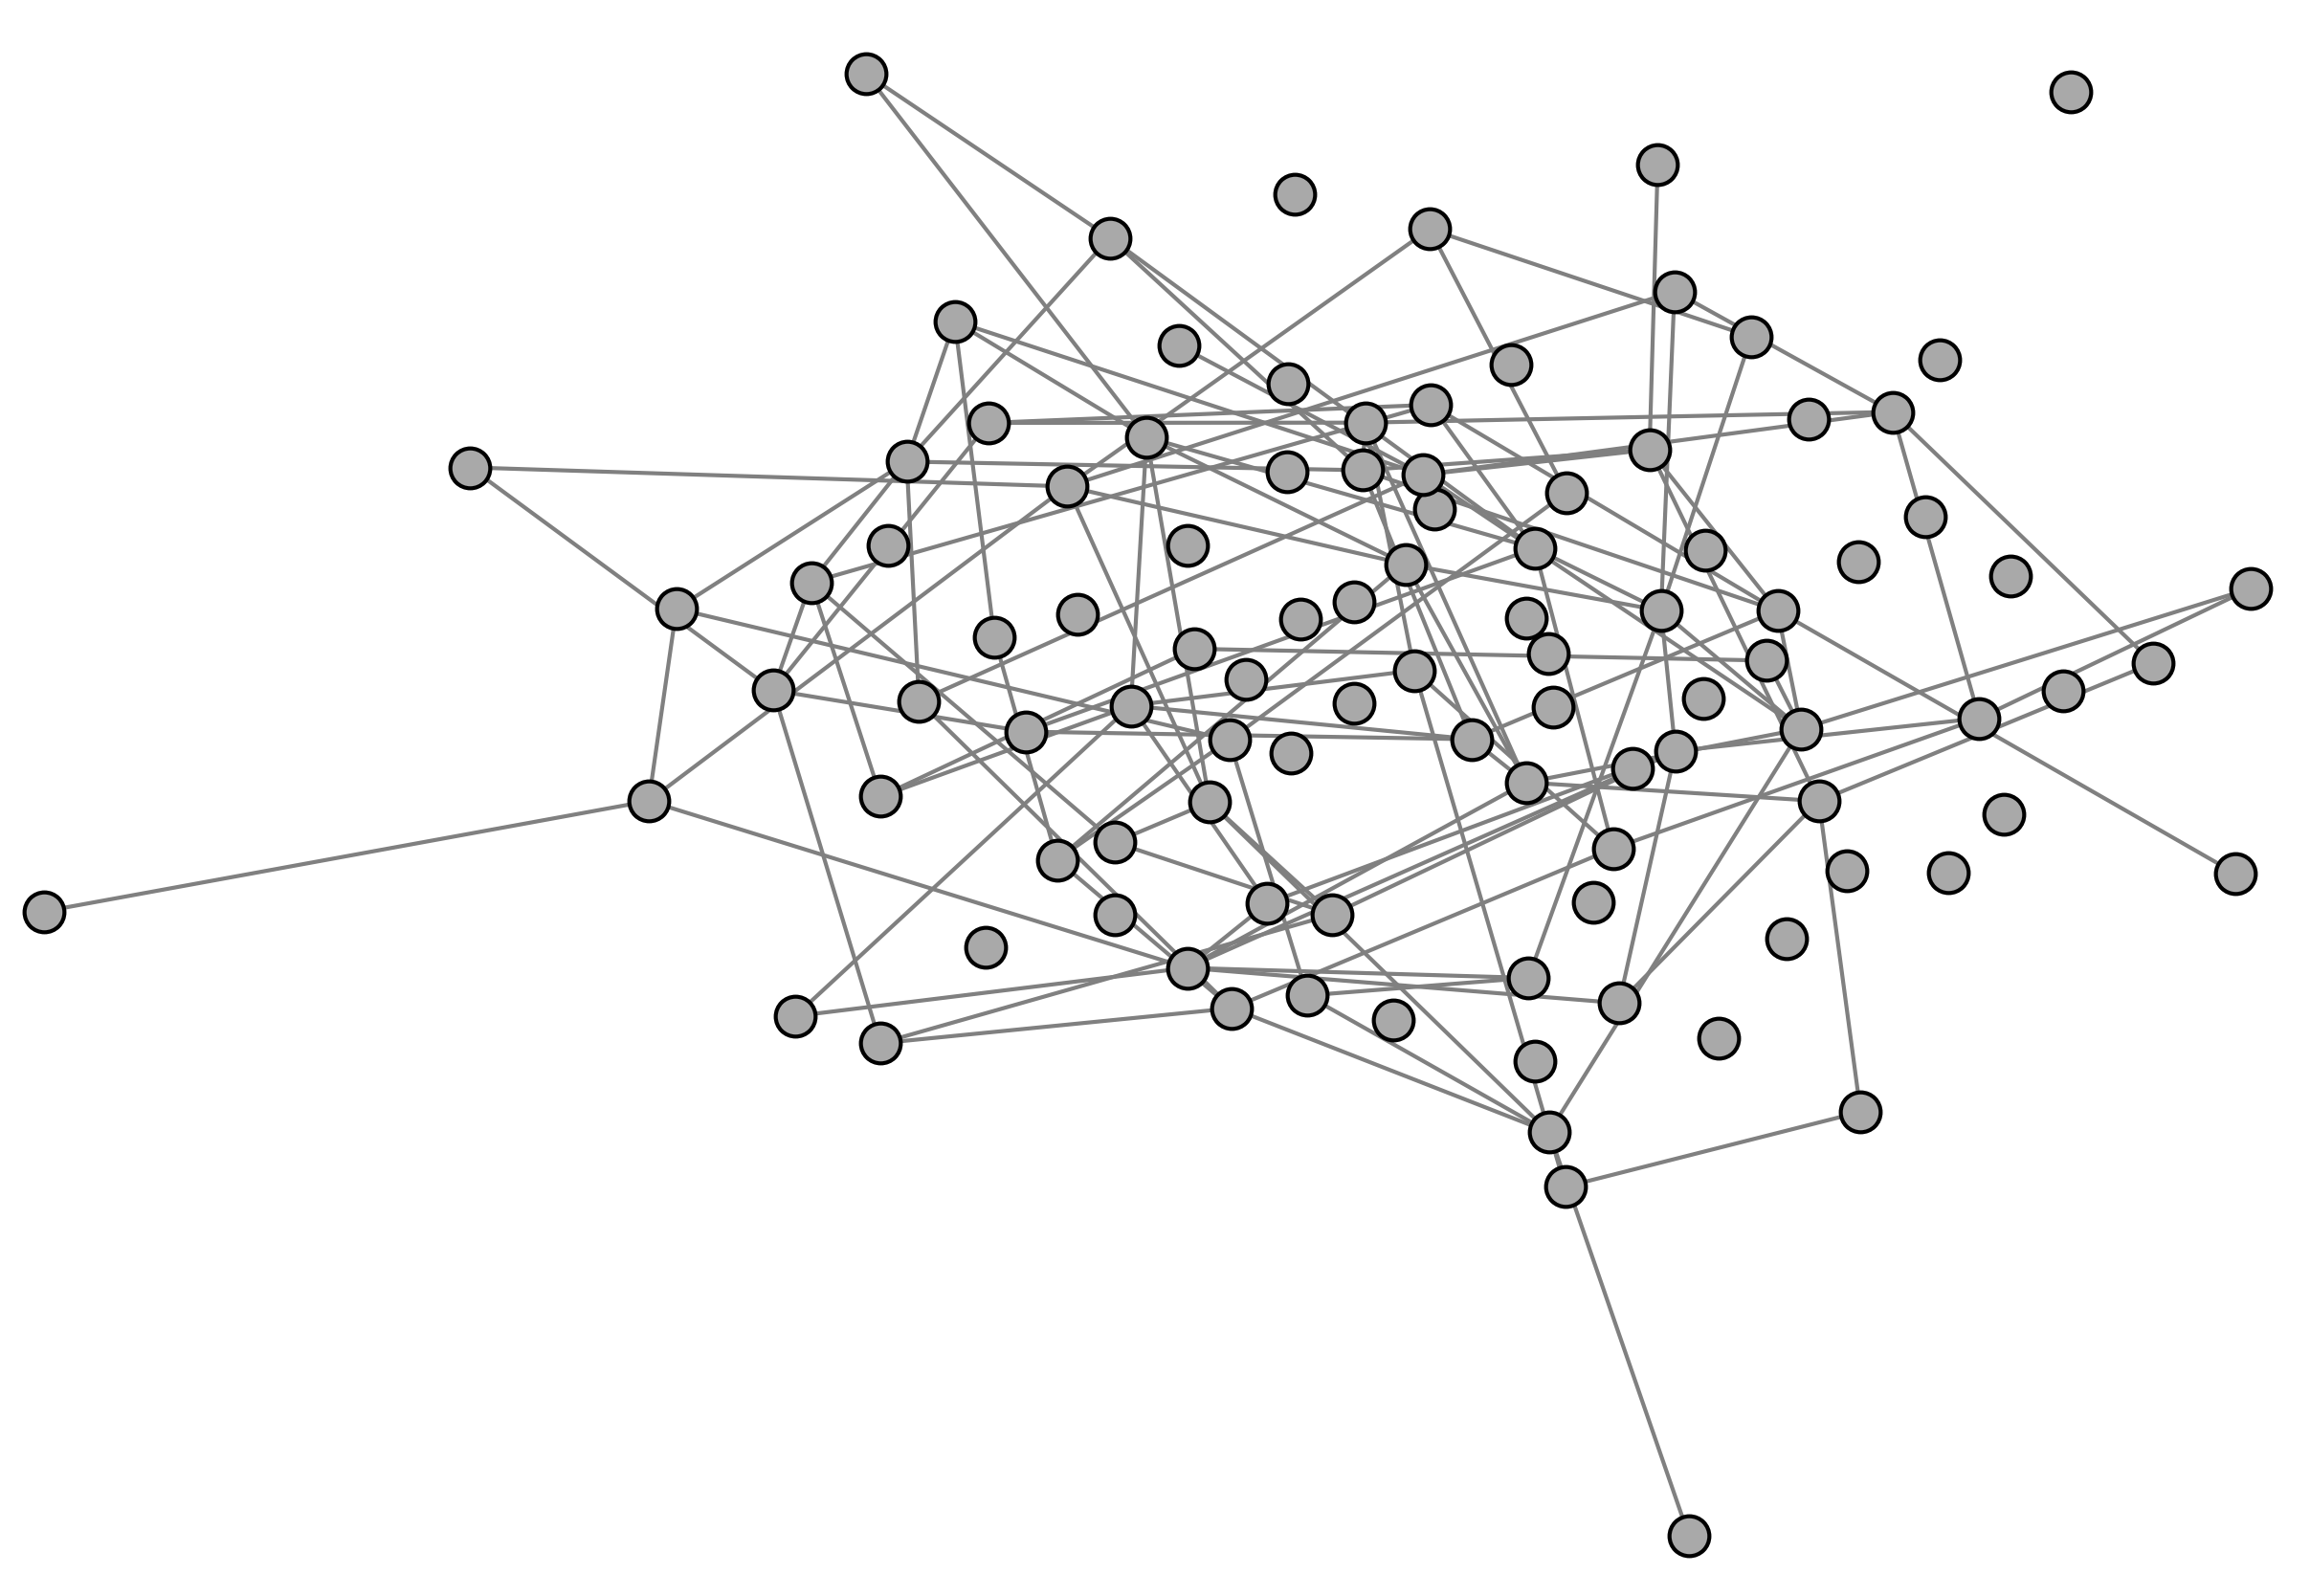
Networks: Static, discrete or continuous-time
Static networks
Temporal networks
Discrete-time
Continuous-time

Slide 6
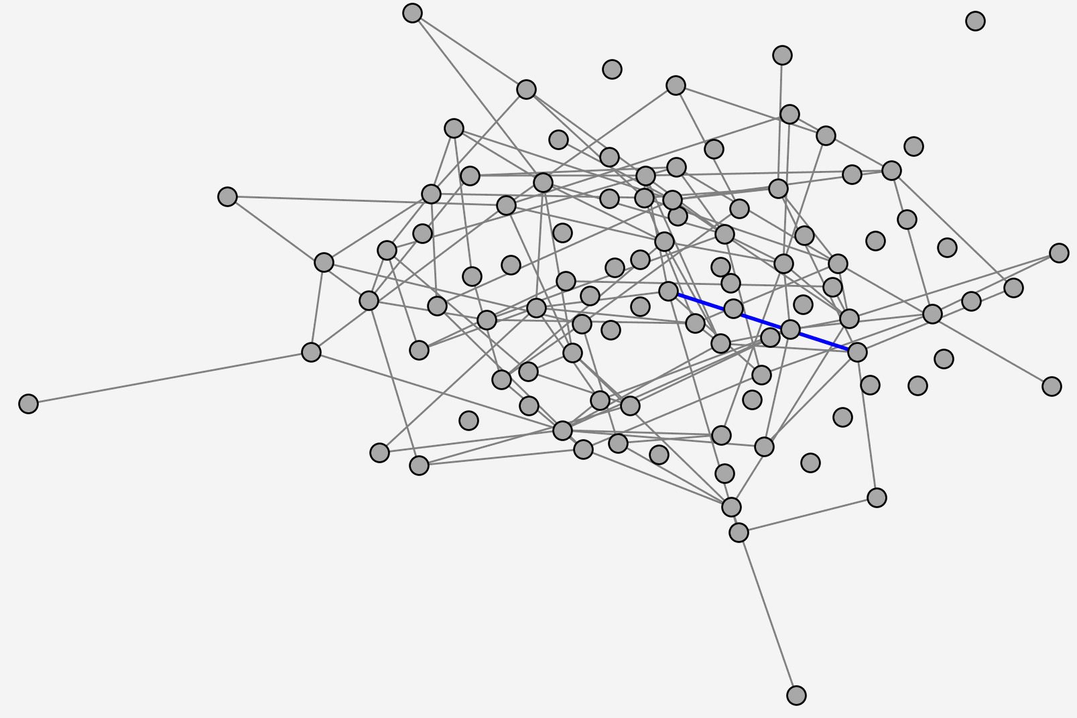
Continuous-time Intermittent Edge Persistent Graphs
Many networks have intermittent linkage structure.
Ex: Interaction networks, Facebook etc
Many dynamic models only account for the event time of links but not their persistence
Static models also assume constant and steady relationships.
Continuous-time Intermittent Edge Persistent Graphs

Slide 7
Sequential Survival Process
Hazard function
Sequential Survival Process
Hazard function
Ref: Jenkins, S. P. 2005. Survival analysis, Institute for Social and Economic Research, University of Essex, Colchester, UK, 42: 54–56.

Slide 8
Objective
Log-likelihood function
Hazard function
Global bias term
State of node pair
Embedding of node j at time t

Slide 9
Continuous-time node representations
Piecewise approximation:
Prior distribution:

Slide 10
Piecewise-Velocity Model For Learning Continuous-time Embeddings
Ref: Celikkanat, Abdulkadir, Nikolaos Nakis, and Morten Mørup. "Piecewise-Velocity Model for Learning Continuous-Time Dynamic Node Representations." Learning on Graphs Conference. PMLR, 2022

Slide 11
Experimental Evaluations
Min. number of events that a dyad has
Max. number of events that a dyad has
Number of nodes
Total number of events

Slide 12
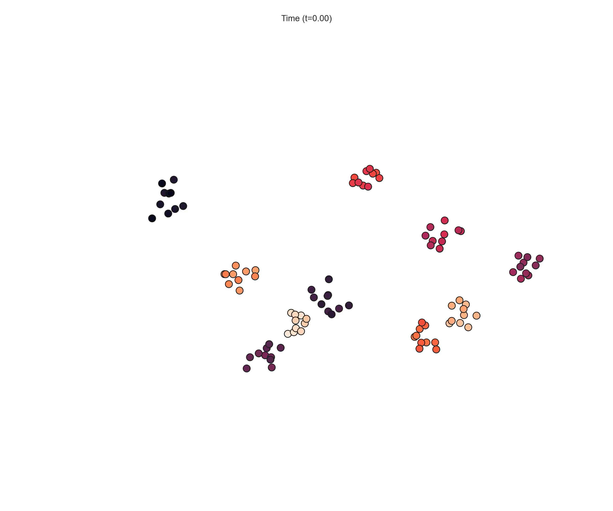
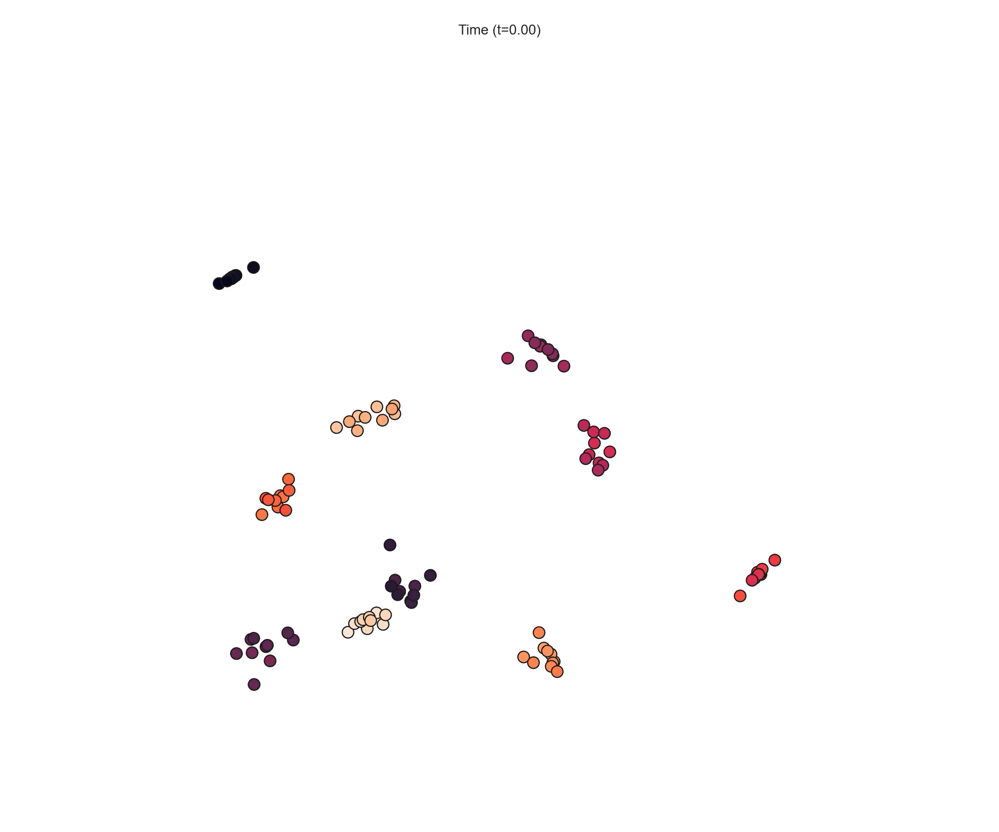
Experiments: Continuous-time Network Visualization
Ground-truth representations
Learned Representations

Slide 13
Experiments: Network completion
Networks often contains noisy or missing links.
We randomly choose 20% node pairs to form validation and testing sets.

Slide 14
Experiments: Future Link Prediction
We aim to predict the last 10% of the links.

Slide 15
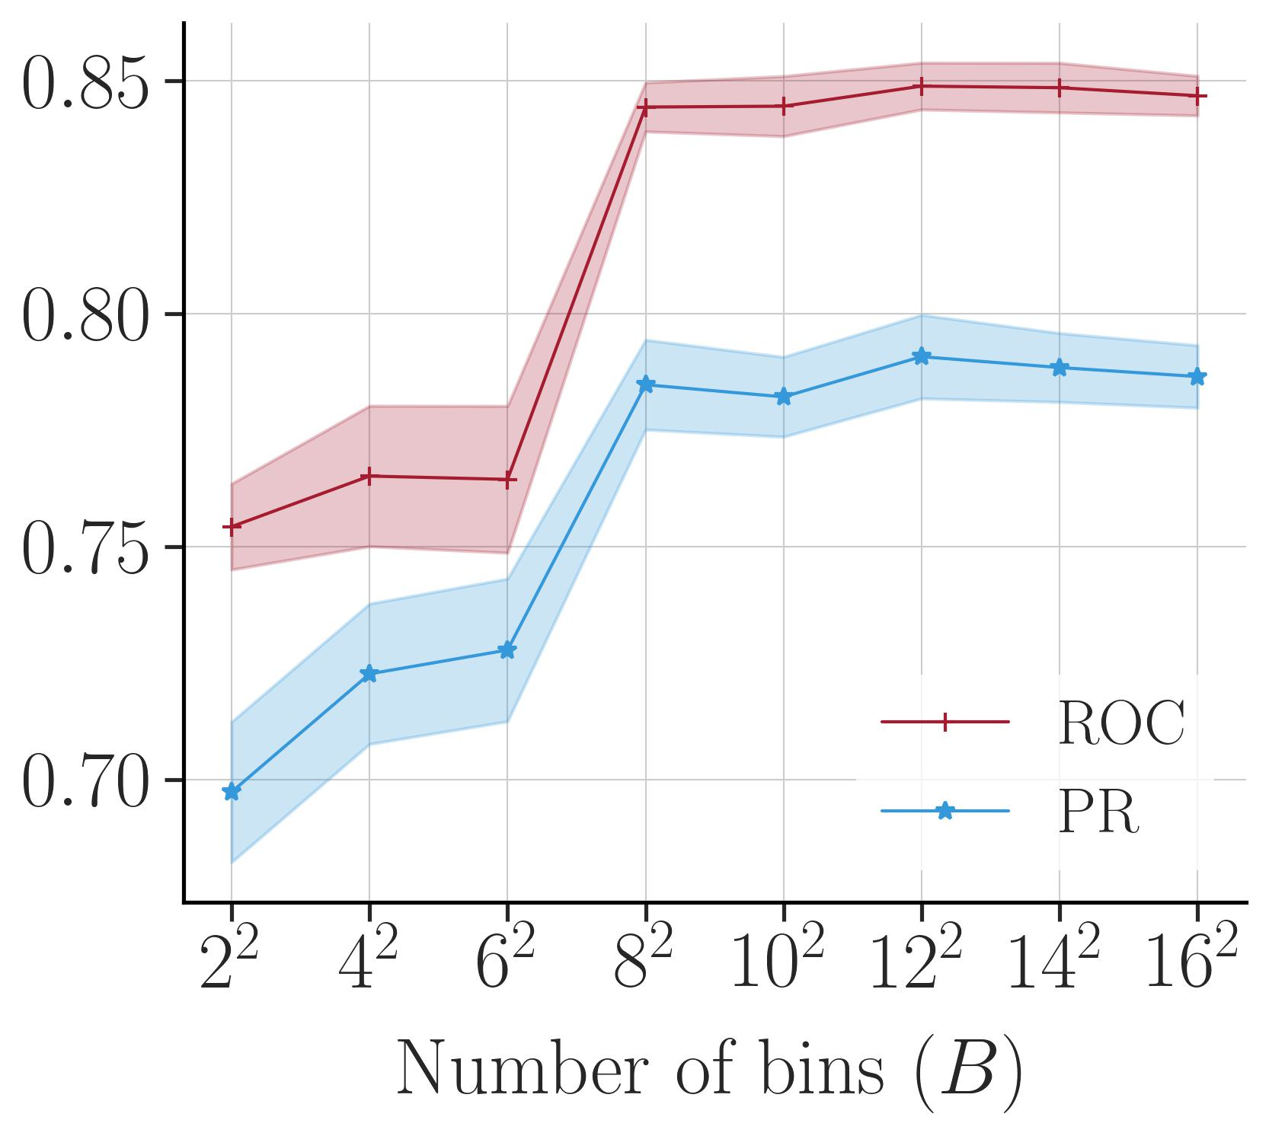
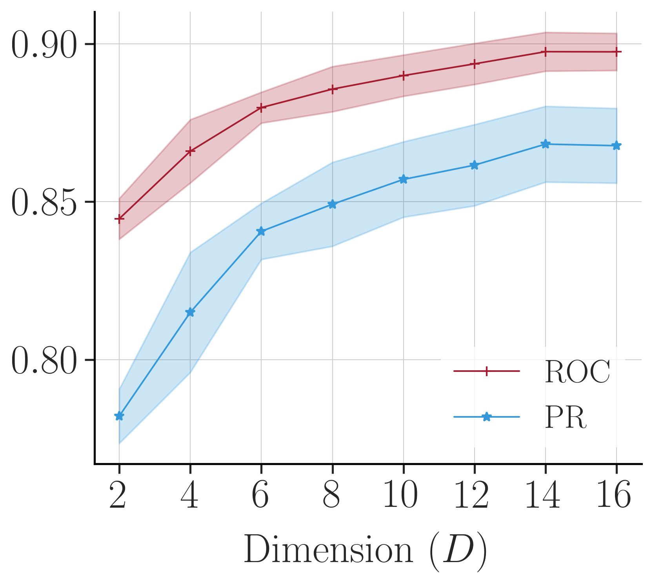
Experiments: Impact of hyperparameters

Slide 16
Conclusion
We propose a novel counting process called the Sequential Survival Process.
We learn latent node representations of continuous-time intermittent edge persistent graphs.
Our approach outperforms the baselines on a wide range of datasets.
Our approach enables continuous-time graph visualization using low-dimensional (D=2) dynamic latent representations.

Slide 17


Thank you!
For the implementation, datasets, animations and other details,
please visit the address:
https://abdcelikkanat.github.io/projects/grassp/

